Slide 1
FIT1045 Introduction to Algorithms and Programming Lecture 17 Implementing Backtracking
COMMONWEALTH OF AUSTRALIA
Copyright Regulations 1969
WARNING
This material has been reproduced and communicated to you by or on behalf of Monash University pursuant to Part VB of the Copyright Act 1968 (the Act).The material in this communication may be subject to copyright under the Act.Any further reproduction or communication of this material by you may be the subject of copyright protection under the Act.
Do not remove this notice.

Slide 2
Overview
General Approach
8 Queens
Permutations
Subsets
Knapsack
Traveling Salesman Problem

Slide 3
Backtracking Main Requirements
Determine a representation of partial solutions.
Keep track of partial solution
Find a set of next positions
Keep track of possible next positions.
Be able to undo steps.
Be able to check whether the partial solution is a solution.

Slide 4


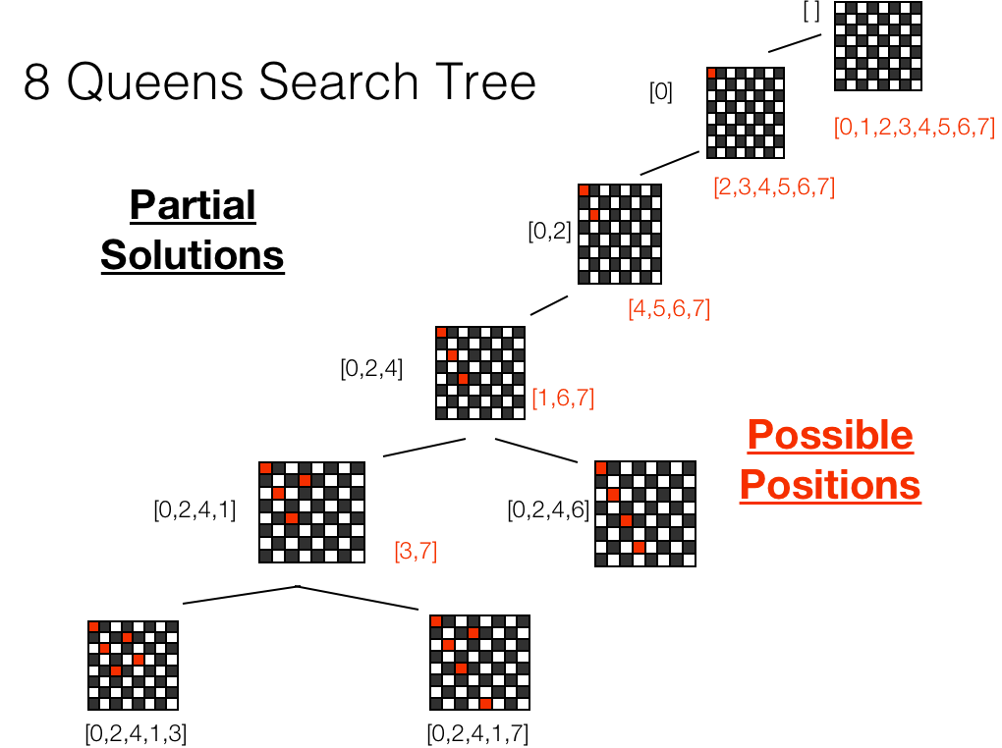
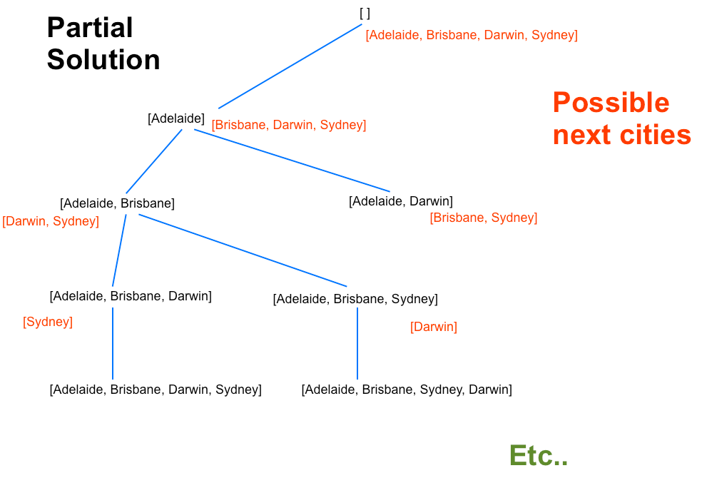

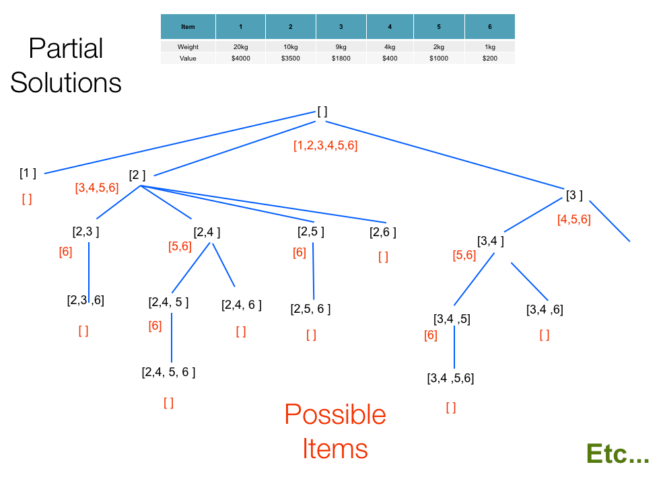

Slide 5
Backtracking Algorithm
def backtrack(partialSolution, otherParameters):
possibleCandidates = getPossibleCandiates(partialSolution)
if possibleCandidates == []:
processSolution(partialSolution)
else:
for item in possibleCandidates:
partialSolution.append(item)
backtrack(partialSolution, otherParameters)
partialSolution.pop()

Slide 6
8 Queens
Q
Consider a standard chessboard. Can you place 8 queens on the board so that none of them are attacking each other?
Notes:
6

Slide 7
[0]
Partial Solutions
[0,1,2,3,4,5,6,7]
[2,3,4,5,6,7]
[0,2]
[4,5,6,7]
Possible
Positions
[0,2,4]
[1,6,7]
[0,2,4,1]
[0,2,4,6]
[3,7]
[0,2,4,1,3]
Etc.
[ ]
[ ]
[0,2,4,1,7]

Slide 8
The number of Queens in the partial solution not attacking each other is?
8
length(partialSolution)-1
Length(partialSolution)
None of the above
1

Slide 9
8 Queens Algorithm
def eightQueens(partialSolution):
positions = getPositions(partialSolution)
if positions == []:
if len(partialSolution) == 8:
print(partialSolution)
else:
for item in positions:
partialSolution.append(item)
eightQueens(partialSolution)
partialSolution.pop()

Slide 10
getPositions([0,2,4,1])
0
1
2
3
4
5
6
7
Q
 |  |  | Q
 | Q
 |  | Q

Slide 11
getPosition Algorithm
getPosition(partialSolution)
{
Let possiblePositions = [0,1,2,3,4,5,6,7]
Let numQueensPlaced = length(partialSolution)
Let nextColumn = numQueensPlaced
if (nextColumn == 8)
{
return []
}
For k = 1 to numQueensPlaced
{
If (row attacked in column nextColumn by the kth queen)
{
Delete row from possiblePositions
}
}
return possiblePositions
}

Slide 12
Permutations N=3
1
2
3
1
3
2
3
1
2
3
2
1
2
3
1
2
1
3

Slide 13
N=3
Partial Solution
[ ]
[ 1, 2, 3 ]
Possible Next Items
[ 1 ]
[ 2 ]
[ 3 ]
[2, 3 ]
[1, 3 ]
[1, 2 ]
[ 1, 2 ]
[ 1, 3 ]
[ 2, 1 ]
[ 2, 3 ]
[ 3, 1 ]
[ 3, 2 ]
[ 3 ]
[ 2 ]
[ 3 ]
[ 1 ]
[ 2 ]
[ 1 ]
[ 1, 2 ,3]
[ 1, 3 ,2]
[ 2, 1 ,3]
[ 2, 3 ,1]
[ 3, 1 ,2]
[ 3, 2 ,1]

Slide 14
Generate Permutation Algorithm
def generatePermutations(partialSolution, N):
possibleItems = getItems(partialSolution, N)
if possibleItems == []:
if len(partialSolution) == N:
print(partialSolution)
else:
for item in possibleItems:
partialSolution.append(item)
generatePermutations(partialSolution, N)
partialSolution.pop()

Slide 15
Bit Lists
000
001
010
011
100
101
110
111
Partial Solution?
Possible Next Items?

Slide 16
When generating bit lists of length N, if len(partialSolution) < N, then next possible bits are always 0 and 1.
True
False
1

Slide 17
Generate Bit Lists Algorithm
def generateBitLists(partialSolution, N):
if len(partialSolution) == N:
print(partialSolution)
else:
for item in [0, 1]:
partialSolution.append(item)
generateBitLists(partialSolution, N)
partialSolution.pop()

Slide 18
Knapsack
Suppose you are in a treasure cave which contains 6 precious items, with the following weights and monetary value.
You want to take as much treasure as you can carry. However, you can only carry up to 20kg. Which items do you take?
Item | 1 | 2 | 3 | 4 | 5 | 6
Weight | 20kg | 10kg | 9kg | 4kg | 2kg | 1kg
Value | $4000 | $3500 | $1800 | $400 | $1000 | $200

Slide 19
Item | 1 | 2 | 3 | 4 | 5 | 6
Weight | 20kg | 10kg | 9kg | 4kg | 2kg | 1kg
Value | $4000 | $3500 | $1800 | $400 | $1000 | $200
[ ]
[1,2,3,4,5,6]
[1 ]
[2 ]
[ ]
[3,4,5,6]
[3 ]
[4,5,6]
$4000
[2,3 ]
[2,4 ]
[2,5 ]
[2,6 ]
[3,4 ]
[6]
[5,6]
[6]
[ ]
[5,6]
Etc..
$3700
[2,3 ,6]
[2,4, 5 ]
[2,4, 6 ]
[2,5, 6 ]
[3,4 ,6]
[3,4 ,5]
[ ]
[6]
[ ]
[ ]
[6]
[ ]
$5500
$2400
$4100
$4700
[2,4, 5, 6 ]
[3,4 ,5,6]
[ ]
[ ]
$5100
$3400

Slide 20
What does the following code print?
def update(old):
old.append(2)
old = [2, 3]
old = [1]
update(old)
print(old)
[1,2]
[2,3]
[1,2,2,3]
[1]
None of the above
1

Slide 21
What does the following code print?
def update(old):
old = [2, 3]
old.append(2)
old = [1]
update(old)
print(old)
[1,2]
[2,3]
[1,2,2,3]
[1]
None of the above
1

Slide 22
The following code prints [2,3].
def update(old):
old.clear()
for item in [2, 3]:
old.append(item)
old = [1]
update(old)
print(old)
True
False
1

Slide 23
Knapsack Algorithm
def knapsack(partialSolution, currentSolution, weights, values):
possibleItems = getItems(partialSolution, weights)
if possibleItems == []:
updateSolution(partialSolution, currentSolution, values)
else:
for item in possibleItems:
partialSolution.append(item)
knapsack(partialSolution, currentSolution, weights, values)
partialSolution.pop()
def updateSolution(partialSolution, currentSolution, values):
knapsackValue = totalValue(partialSolution, values)
currentMax = totalValue(currentSolution, values)
if knapsackValue > currentMax:
currentSolution.clear()
for item in partialSolution:
currentSolution.append(item)

Slide 24
Knapsack Algorithm
def knapsack(partialSolution, currentSolution, weights, values):
possibleItems = getItems(partialSolution)
if possibleItems == []:
knapsackValue = totalValue(partialSolution, values)
currentMax = totalValue(currentSolution, values)
if knapsackValue > currentMax:
currentSolution = partialSolution
else:
for item in possibleItems:
partialSolution.append(item)
currentSolution = knapsack(partialSolution, currentSolution, weights, values)
partialSolution.pop()
return currentSolution

Slide 25
Traveling Salesman
Suppose you are given the following driving distances in kms between the following capital cities.
Find the shortest route that enables a salesman to start at Canberra, visit all the other cities, before returning to Canberra.
 | Adelaide | Brisbane | Canberra | Darwin | Sydney
Adelaide |  | 2053 | 1155 | 3017 | 1385
Brisbane | 2053 |  | 1080 | 3415 | 939
Canberra | 1155 | 1080 |  | 3940 | 285
Darwin | 3017 | 3415 | 3940 |  | 3975
Sydney | 1385 | 939 | 285 | 3975

Slide 26
Partial Solution
[ ]
[Adelaide, Brisbane, Darwin, Sydney]
Possible next cities
[Adelaide]
[Brisbane, Darwin, Sydney]
[Adelaide, Brisbane]
[Adelaide, Darwin]
Etc..
[Darwin, Sydney]
[Brisbane, Sydney]
[Adelaide, Brisbane, Darwin]
[Adelaide, Brisbane, Sydney]
[Sydney]
[Darwin]
[Adelaide, Brisbane, Darwin, Sydney]
[Adelaide, Brisbane, Sydney, Darwin]

Slide 27
TSP Algorithm
def tsp(partialSolution, currentSolution, distances):
possibleCities = getCities(partialSolution, distances)
if possibleCities == []:
routeLength = totalRoute(partialSolution, distances)
currentMin = totalRoute(currentSolution, distances)
if routeLength < currentMin:
currentSolution = partialSolution
else:
for city in possibleCities:
partialSolution.append(city)
currentSolution = tsp(partialSolution, currentSolution, distances)
partialSolution.pop()
return currentSolution

Slide 28
Before Next Lecture
Reading: The Design & Analysis of Algorithms
Chapter 12.1 Backtracking
Chapter 4.1 - 4.2 Sorting Algorithms
Watch the following videos:
Recursion II – Recursive tree search
Heaps

